Slide 1
GAS MAIN REPLACEMENT –
SOUTH FOUR CORNERS CITIZENS ASSOCIATION
Brendan Gamble, Construction Manager

Slide 2
INTRODUCTION
PROJECT PARTICIPANTS
  DESIGN
    Jeffrey Hicks, System Replacement Engineer
  CONSTRUCTION
    Brendan Gamble, Manager
    Jason Rich, Supervisor
  CORPORATE RELATIONS
    Kelly Gibson Caplan, Community Outreach Manager
SOUTH FOUR CORNERS SERVICE AREA

Slide 3
PROJECT SCOPE
Approximately 29,035 feet of existing high pressure bare/wrapped steel gas main will be replaced with high pressure plastic gas main
  Increased reliability and added capacity
677 affected customers
  470 service laterals will be replaced due to material type
  207 service laterals will be switched over to the new main
Notes:
MEDIUM PRESSURE OPERATES BETWEEN 1 PSIG TO 60 PSIG INCLUSIVELY
HIGH EFFICIENCY
DURING MAIN REPLACEMENT, THE FOLLOWING SERVICE TYPES ARE REPLACED:
BARE STEEL
WRAPPED STEEL
COPPER
BLACK PLASTIC
PRE-1975 PLASTIC
POST-1975 PLASTIC IS TRANSFERRED (AKA CHANGED OVER) TO NEW MAIN

Slide 4
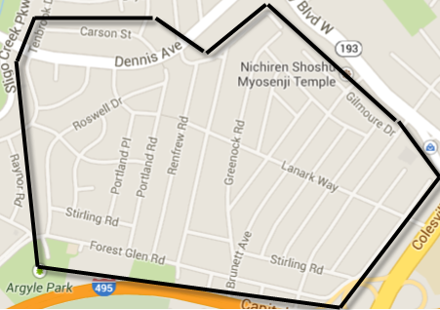
PROJECT AREA

Slide 5
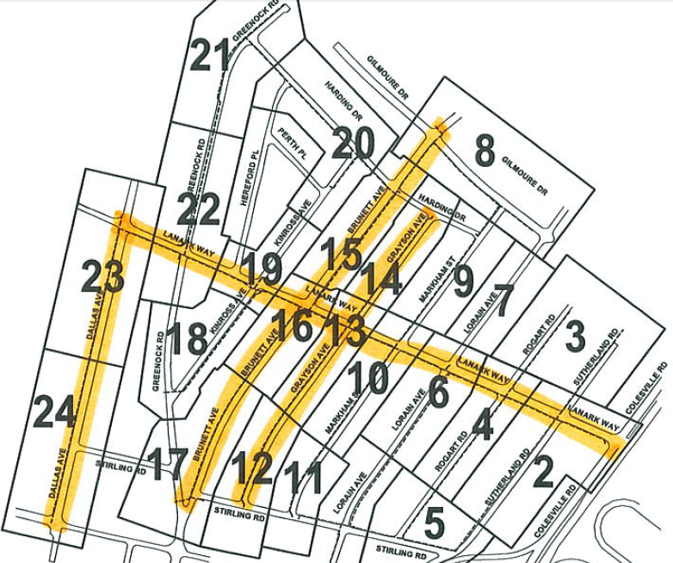

Slide 6
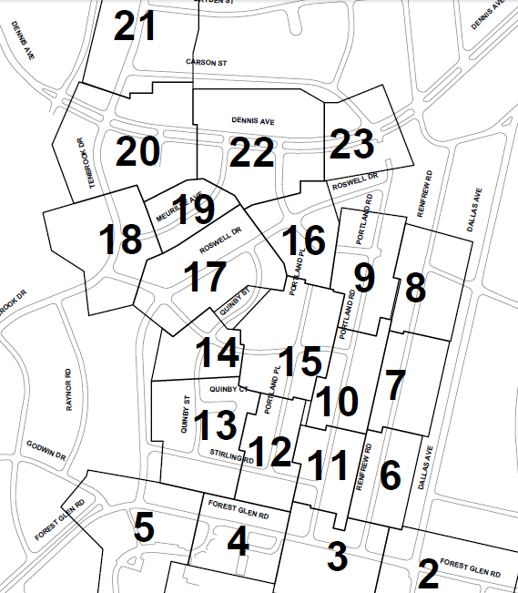
PROJECT AREA

Slide 7
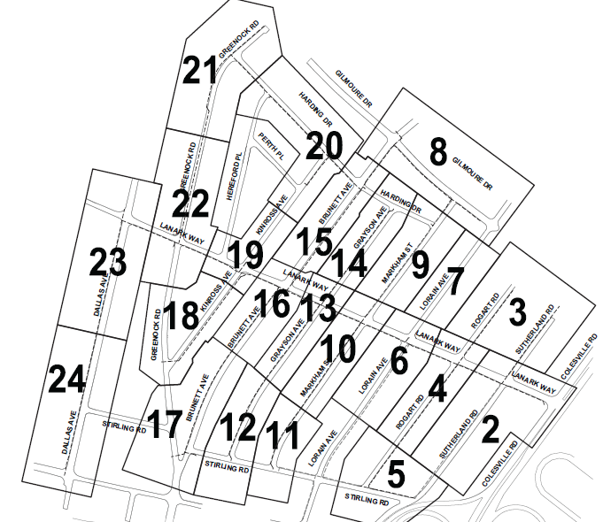
PROJECT AREA

Slide 8
CONSTRUCTION
Construction method
  Majority of project involves directionally drilling the new main pipe and service
    Minimizes disruption
  Existing field conditions may alter design and installation method
Construction Process
  Temporary shut off of gas during replacement or changeover of service
  Inside meters will be moved outside
Restoration
  Private property and yards will be restored as close to their original state as possible
  Road restoration will occur in sections as construction is completed

Slide 9
CONSTRUCTION
Schedule of Work
  Phase 1 (April 2014 – August 2014)
  Phase 2 (June 2014 – October 2014)
  Phase 3 (October 2014 – March 2015)
Notification to Residents
  Notice of Utility Construction via letter
  Miss Utility marks
  Door hangers
  No Parking Signs along affected street(s)

Slide 10
POINTS OF CONTACT
Jeffrey Hicks, System Replacement Engineer
  (703) 750-5972 office
  JHicks@washgas.com
Brendan Gamble, Construction Manager
  (202) 624-6439 office
  (703) 343-0395 mobile
  BGamble@washgas.com
Jason Rich, Construction Supervisor
  (703) 408-2086 mobile
  JRich@washgas.com
Kelly Gibson Caplan, Community Outreach Manager
  (202) 624-6335 office
  Kelly.Caplan@washgas.com

Slide 11
QUESTIONS?

